Slide 1

Data Preparation Techniques Project
Using Automotive data from MarketCheck
By Ojo, Oluwaseun Samuel & Sholola, Oluwafunmiwo Judah

Slide 2
ITERATION ONE

Slide 3
Brief Description of the dataset
Automotive dataset from MarketCheck spanning 8 years of inventory in Canada
From [Kaggle link], it was updated a year ago, so we can reasonably expect 2021 to be the upper limit for the year of car manufacture
Comprises some expected attributes such as the price, make, mileage and manufacturing year of the car
It also includes more specific attributes such as the fuel type, the engine size, the (corporate) dealer name and site of activity (zip and province).

Slide 4
Data Exploration

Slide 5
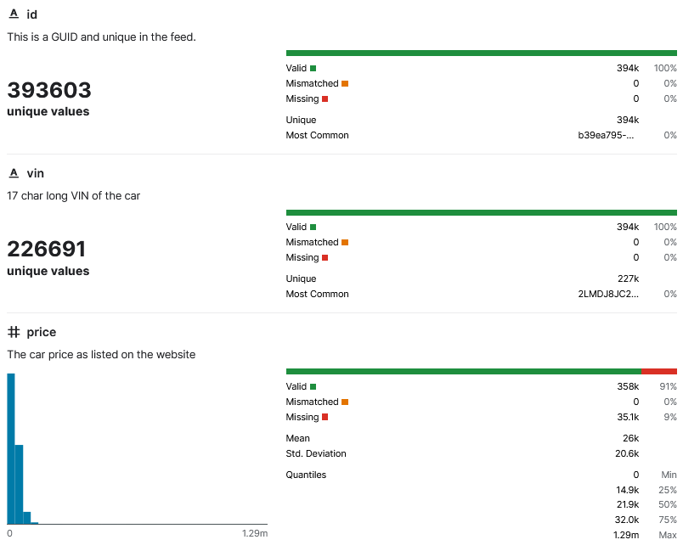
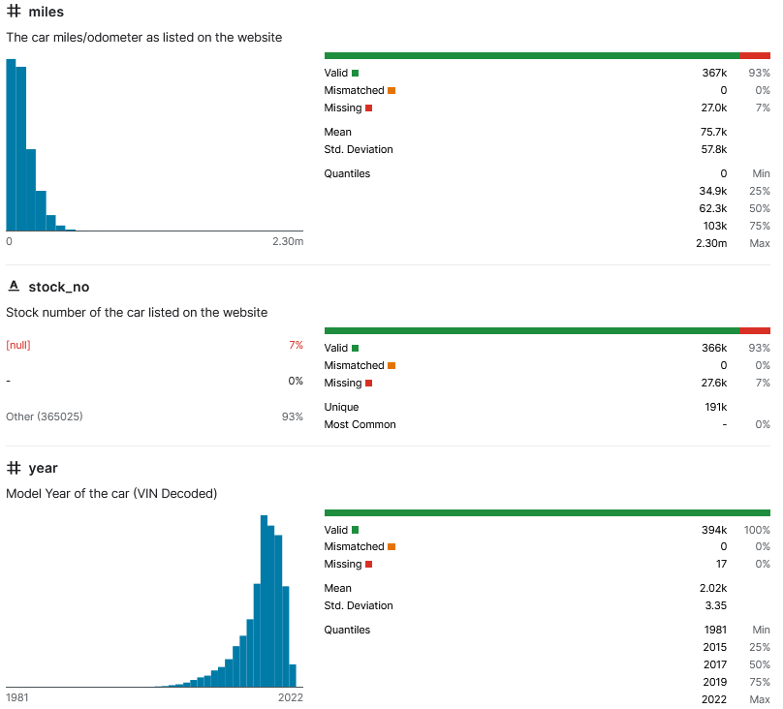
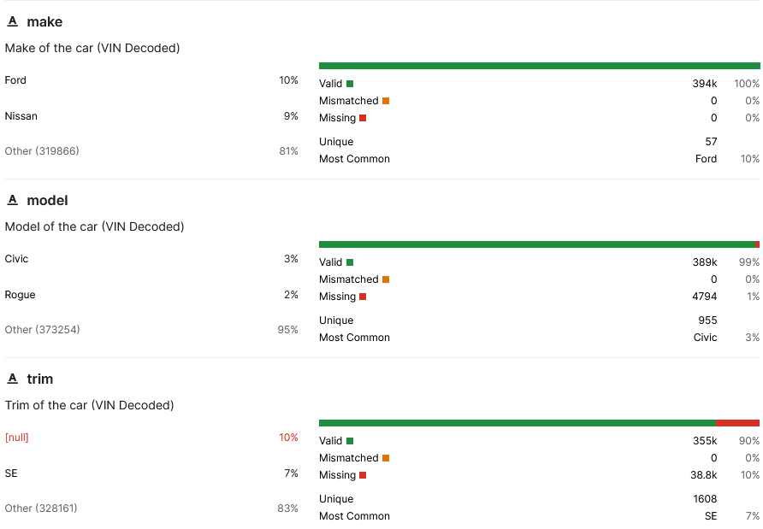
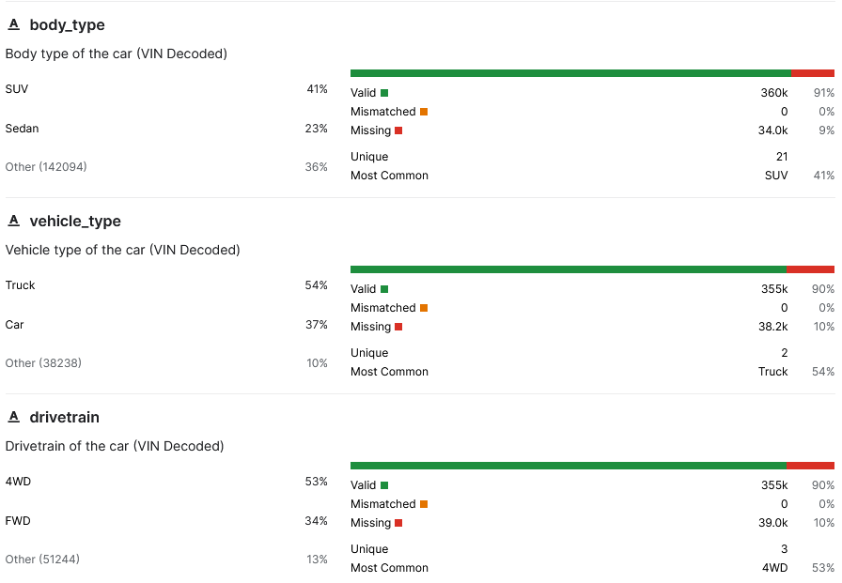

Slide 6
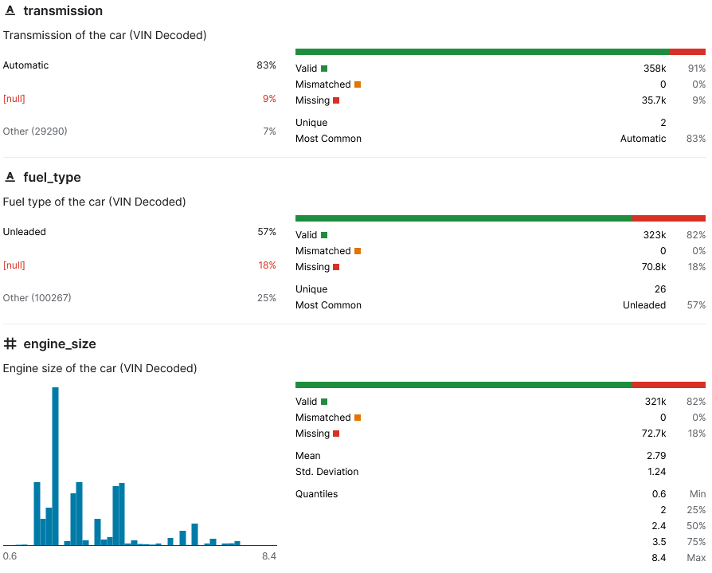
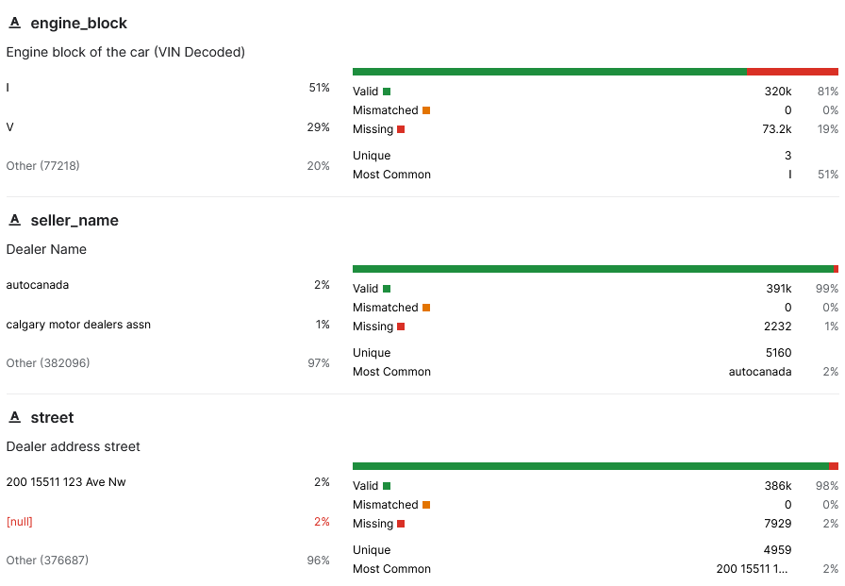
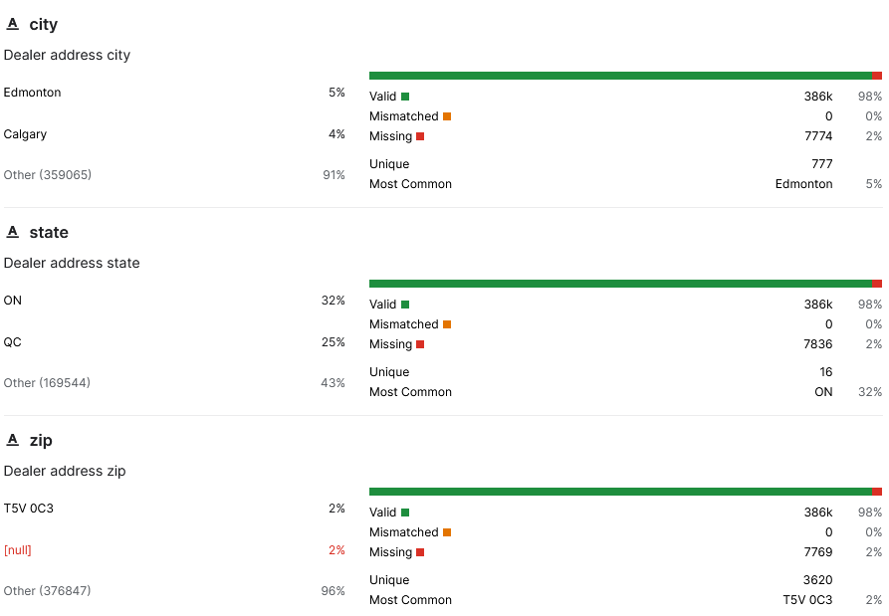
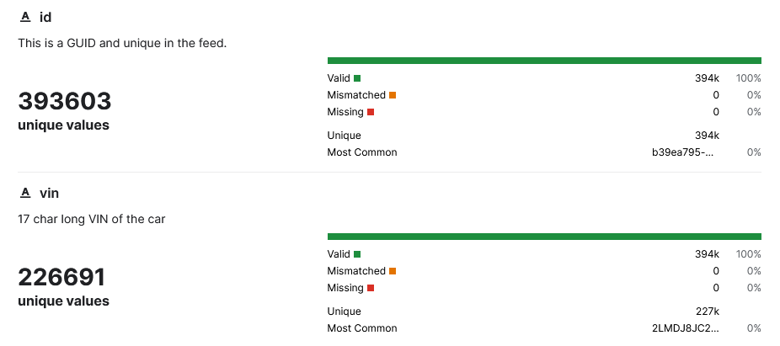


Slide 7
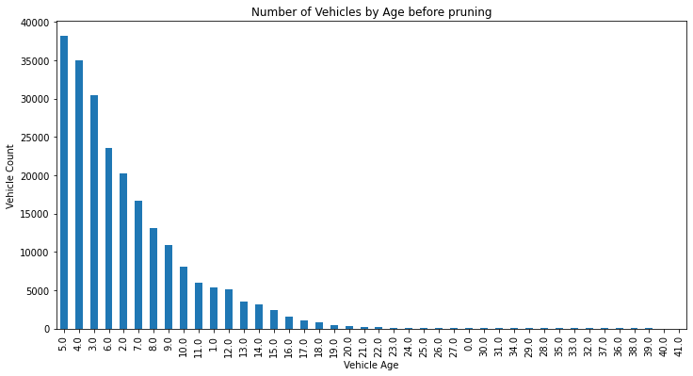
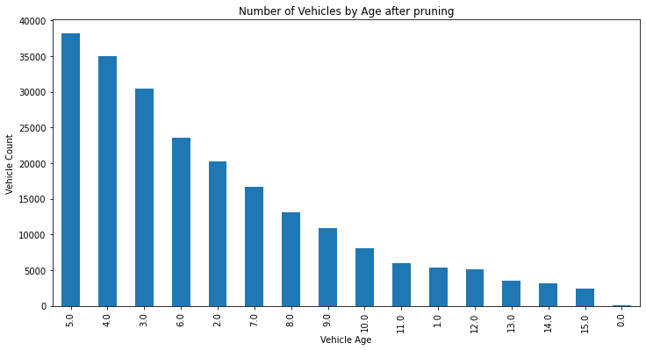
- we derived a new column, age, based off the manufacturing year, which we use to prune off vehicles that fall outside a specific range
- we are choosing to deal only with cars that were manufactured more recently

Slide 8
Dropping Attributes
The following attributes were dropped from our dataframe and our justification for dropping them
Stock Number
Unique to each dealer's online inventory categorization system, and is not of a singular format; some are purely numeric in nature, while some are alphanumeric. As such, it is not extremely useful across diverse sources (dealers).
2. Trim
We decided to drop this attribute because of the sheer number of unique values it contains per make.

Slide 9
3. Engine Block
The engine_block code in the VIN differs across make and models. As such, it rapidly devolves into an arduous task in trying to retrieve an attribute that we do not view as useful to our goal(s).
4. Street
This attribute is being dropped in favour of 2 other geo-based attributes, city and state.
5. Zip
This attribute is also being dropped in favour of 2 other geo-based attributes, city and state.
Notes:
Unlike some other attributes such as the manufacturing year, which can be decoded from the VIN and are uniform/standard across various vehicle manufacturers, engine block code is unique to manufacturers.

Slide 10
Filling Missing Data & Handling Outliers

Slide 11
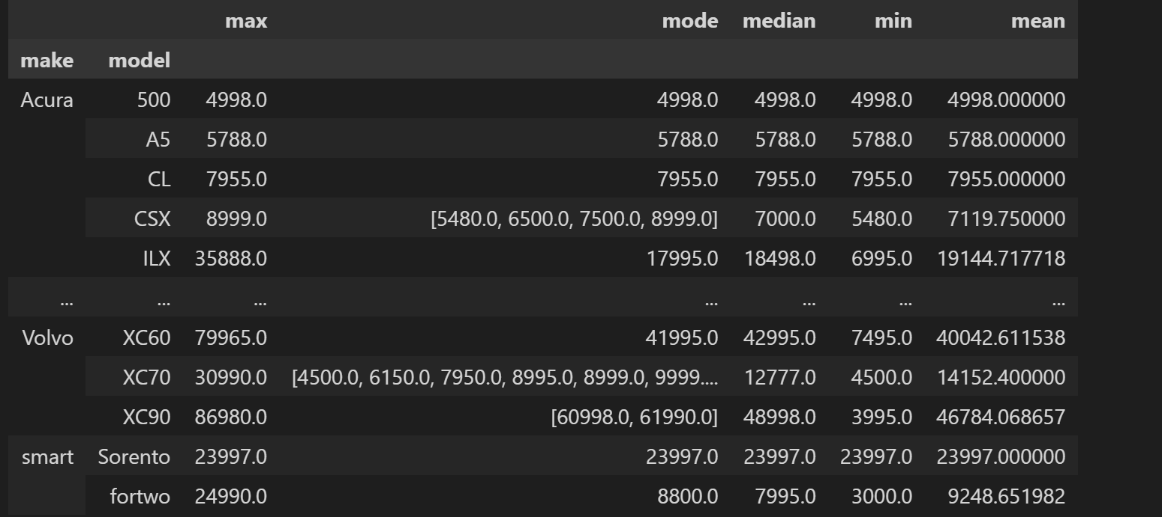
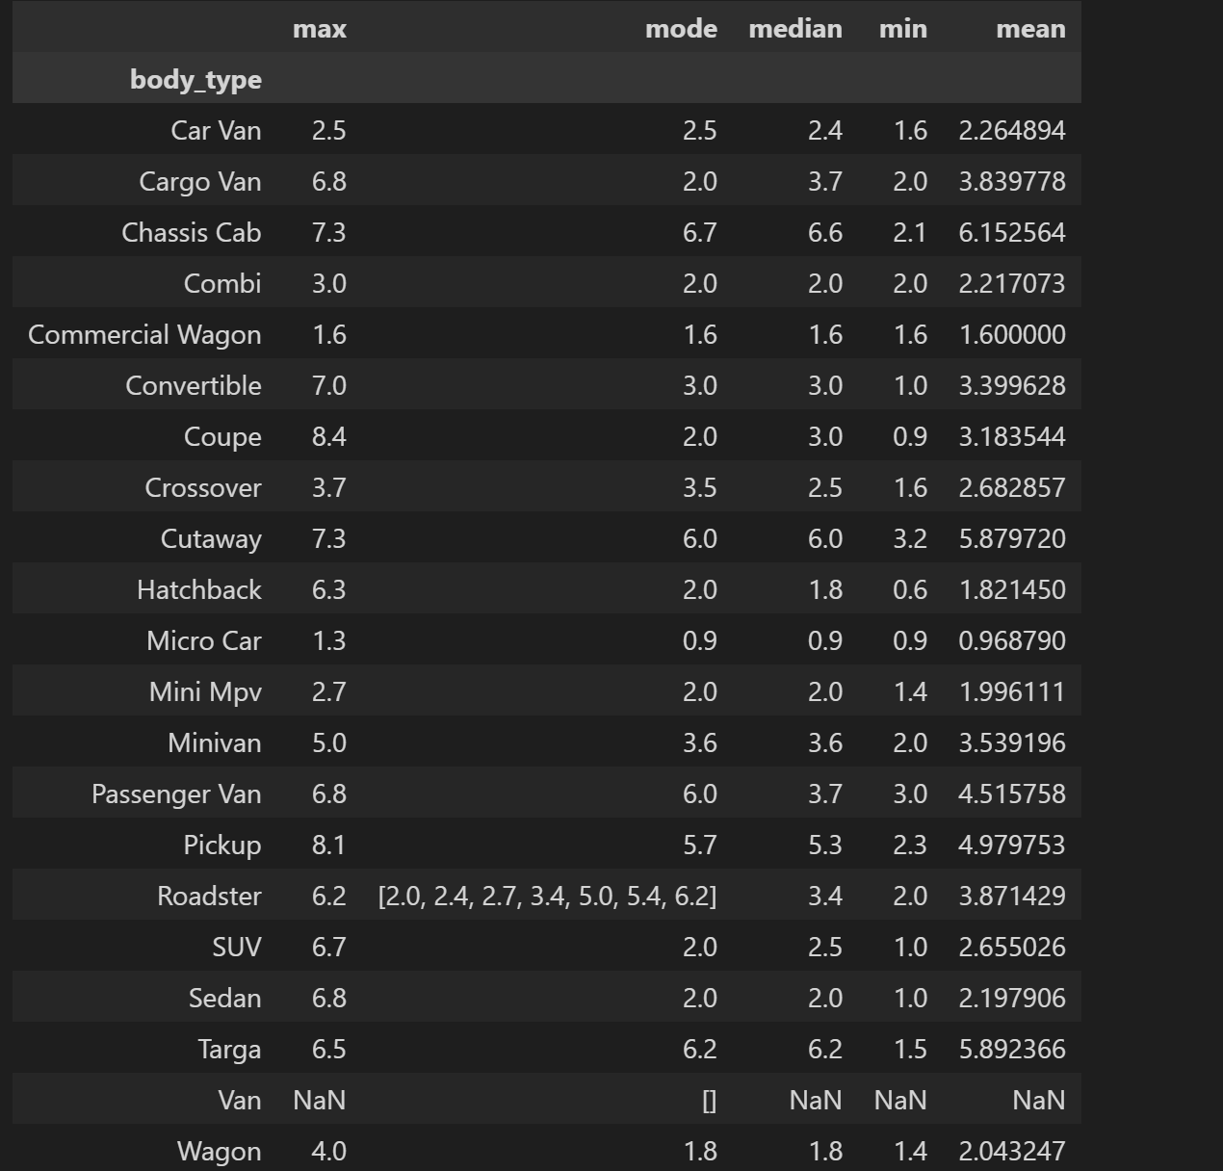
Missing Data
Price: About 9% is missing from the original dataset, so we artificially introduced 6% more missing values into the dataset, to make 15% of missing values. For our baseline, we replace these missing values with the average price for the make and model of the vehicle.
Engine Size: About 18% of values are missing from this attribute in the original dataset. We utilize centrality measures (mode), based on categorization for a related attribute, body_type, to fill missing values.
Notes:
- drop rows with price = 0

Slide 12
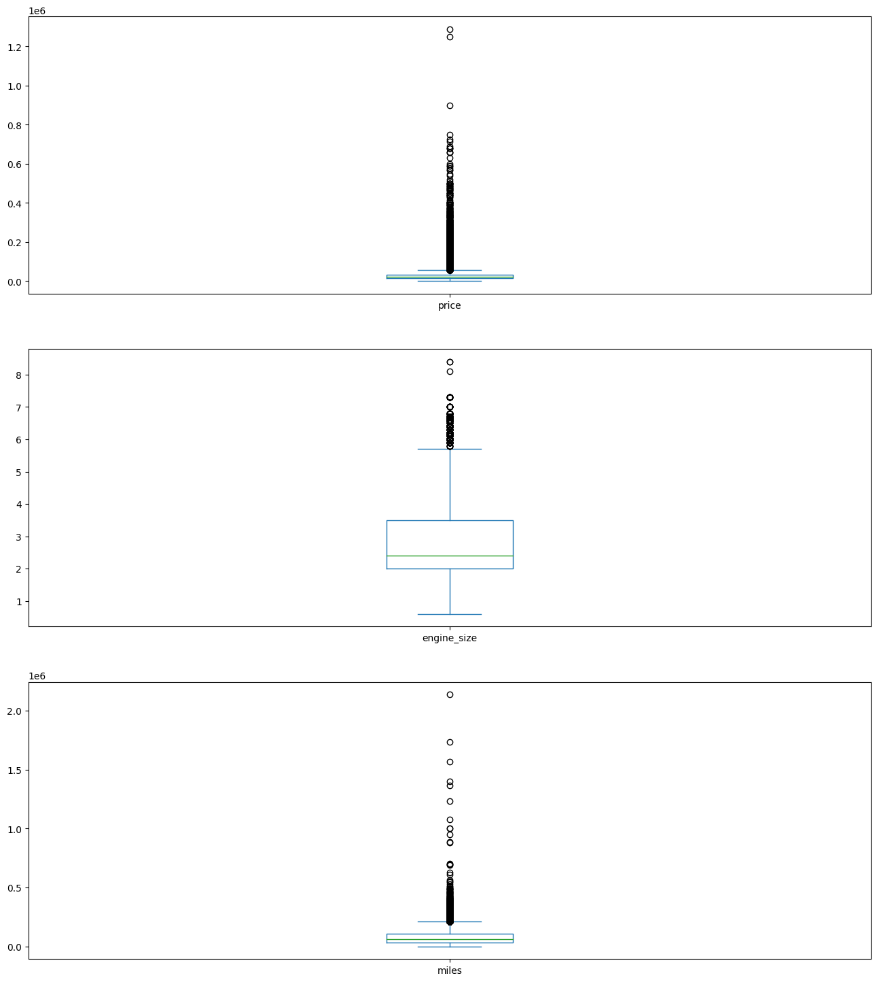
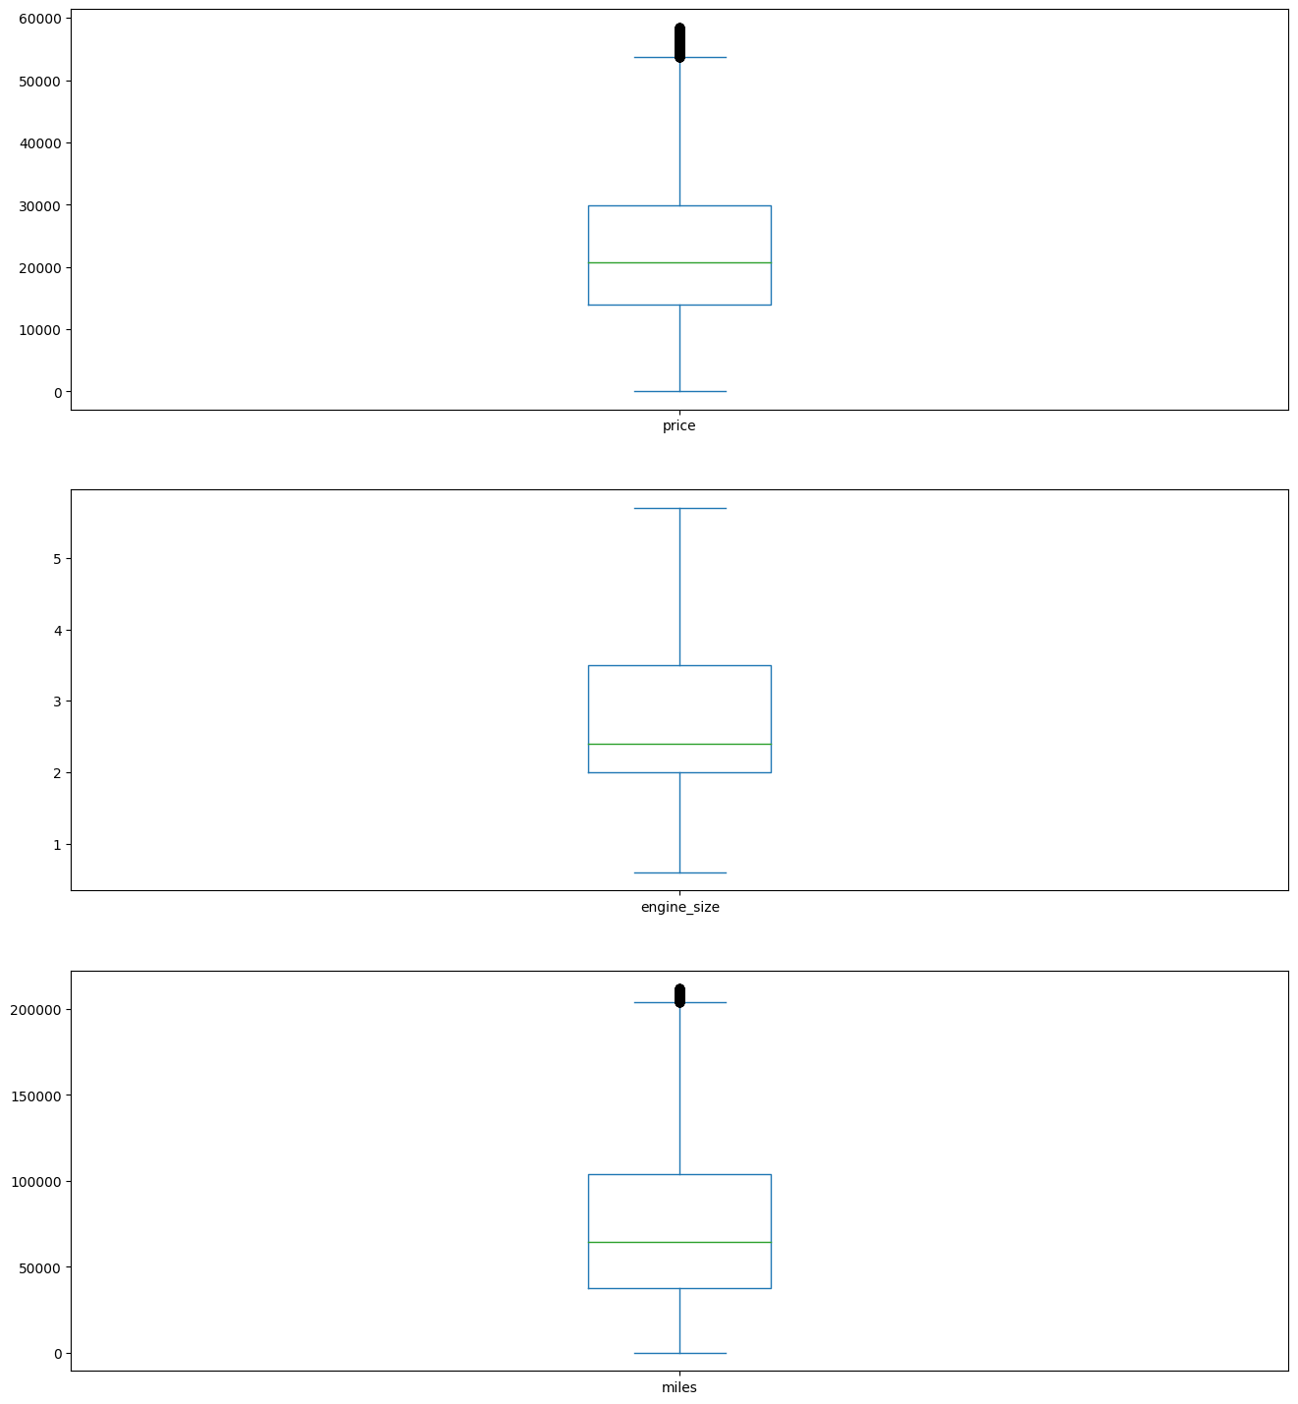
Handling Outliers
Before Handling Outliers:
After Handling Outliers:
First, we save a copy of the rows with outliers under these attributes
After fixing these outliers, we remove them from our clean dataset.

Slide 13
Final Clean Up

Slide 14
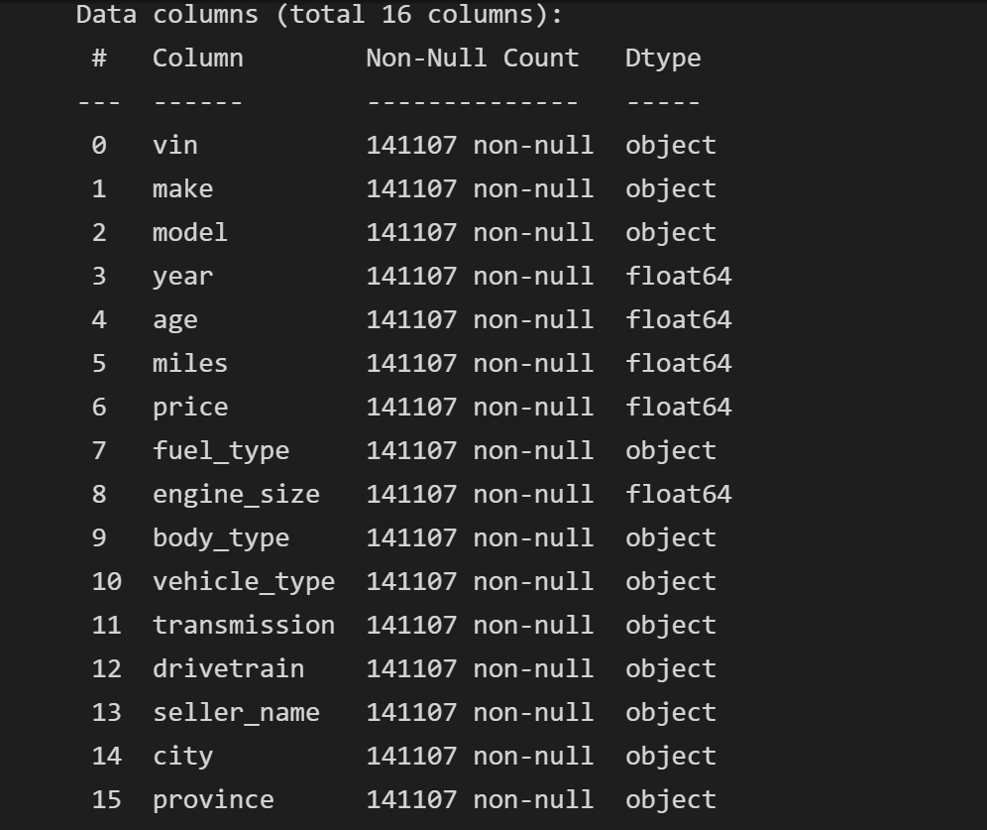
Finally, we drop the rows with outliers and missing values from certain columns:
vin : fundamental attribute, cannot be retrieved from others
miles : cannot be retrieved from any other columns
model : is obfuscated in VIN (not a 1-to-1 mapping) since it varies across manufacturers (makes)
body_type : is also obfuscated in VIN (unique to each make); if missing for a particular model of a make, cannot be retrieved from other models
city and province: even if seller_name is available, if city is missing, it is missing in all instances of seller_name.

Slide 15
Distribution of our attributes

Slide 16
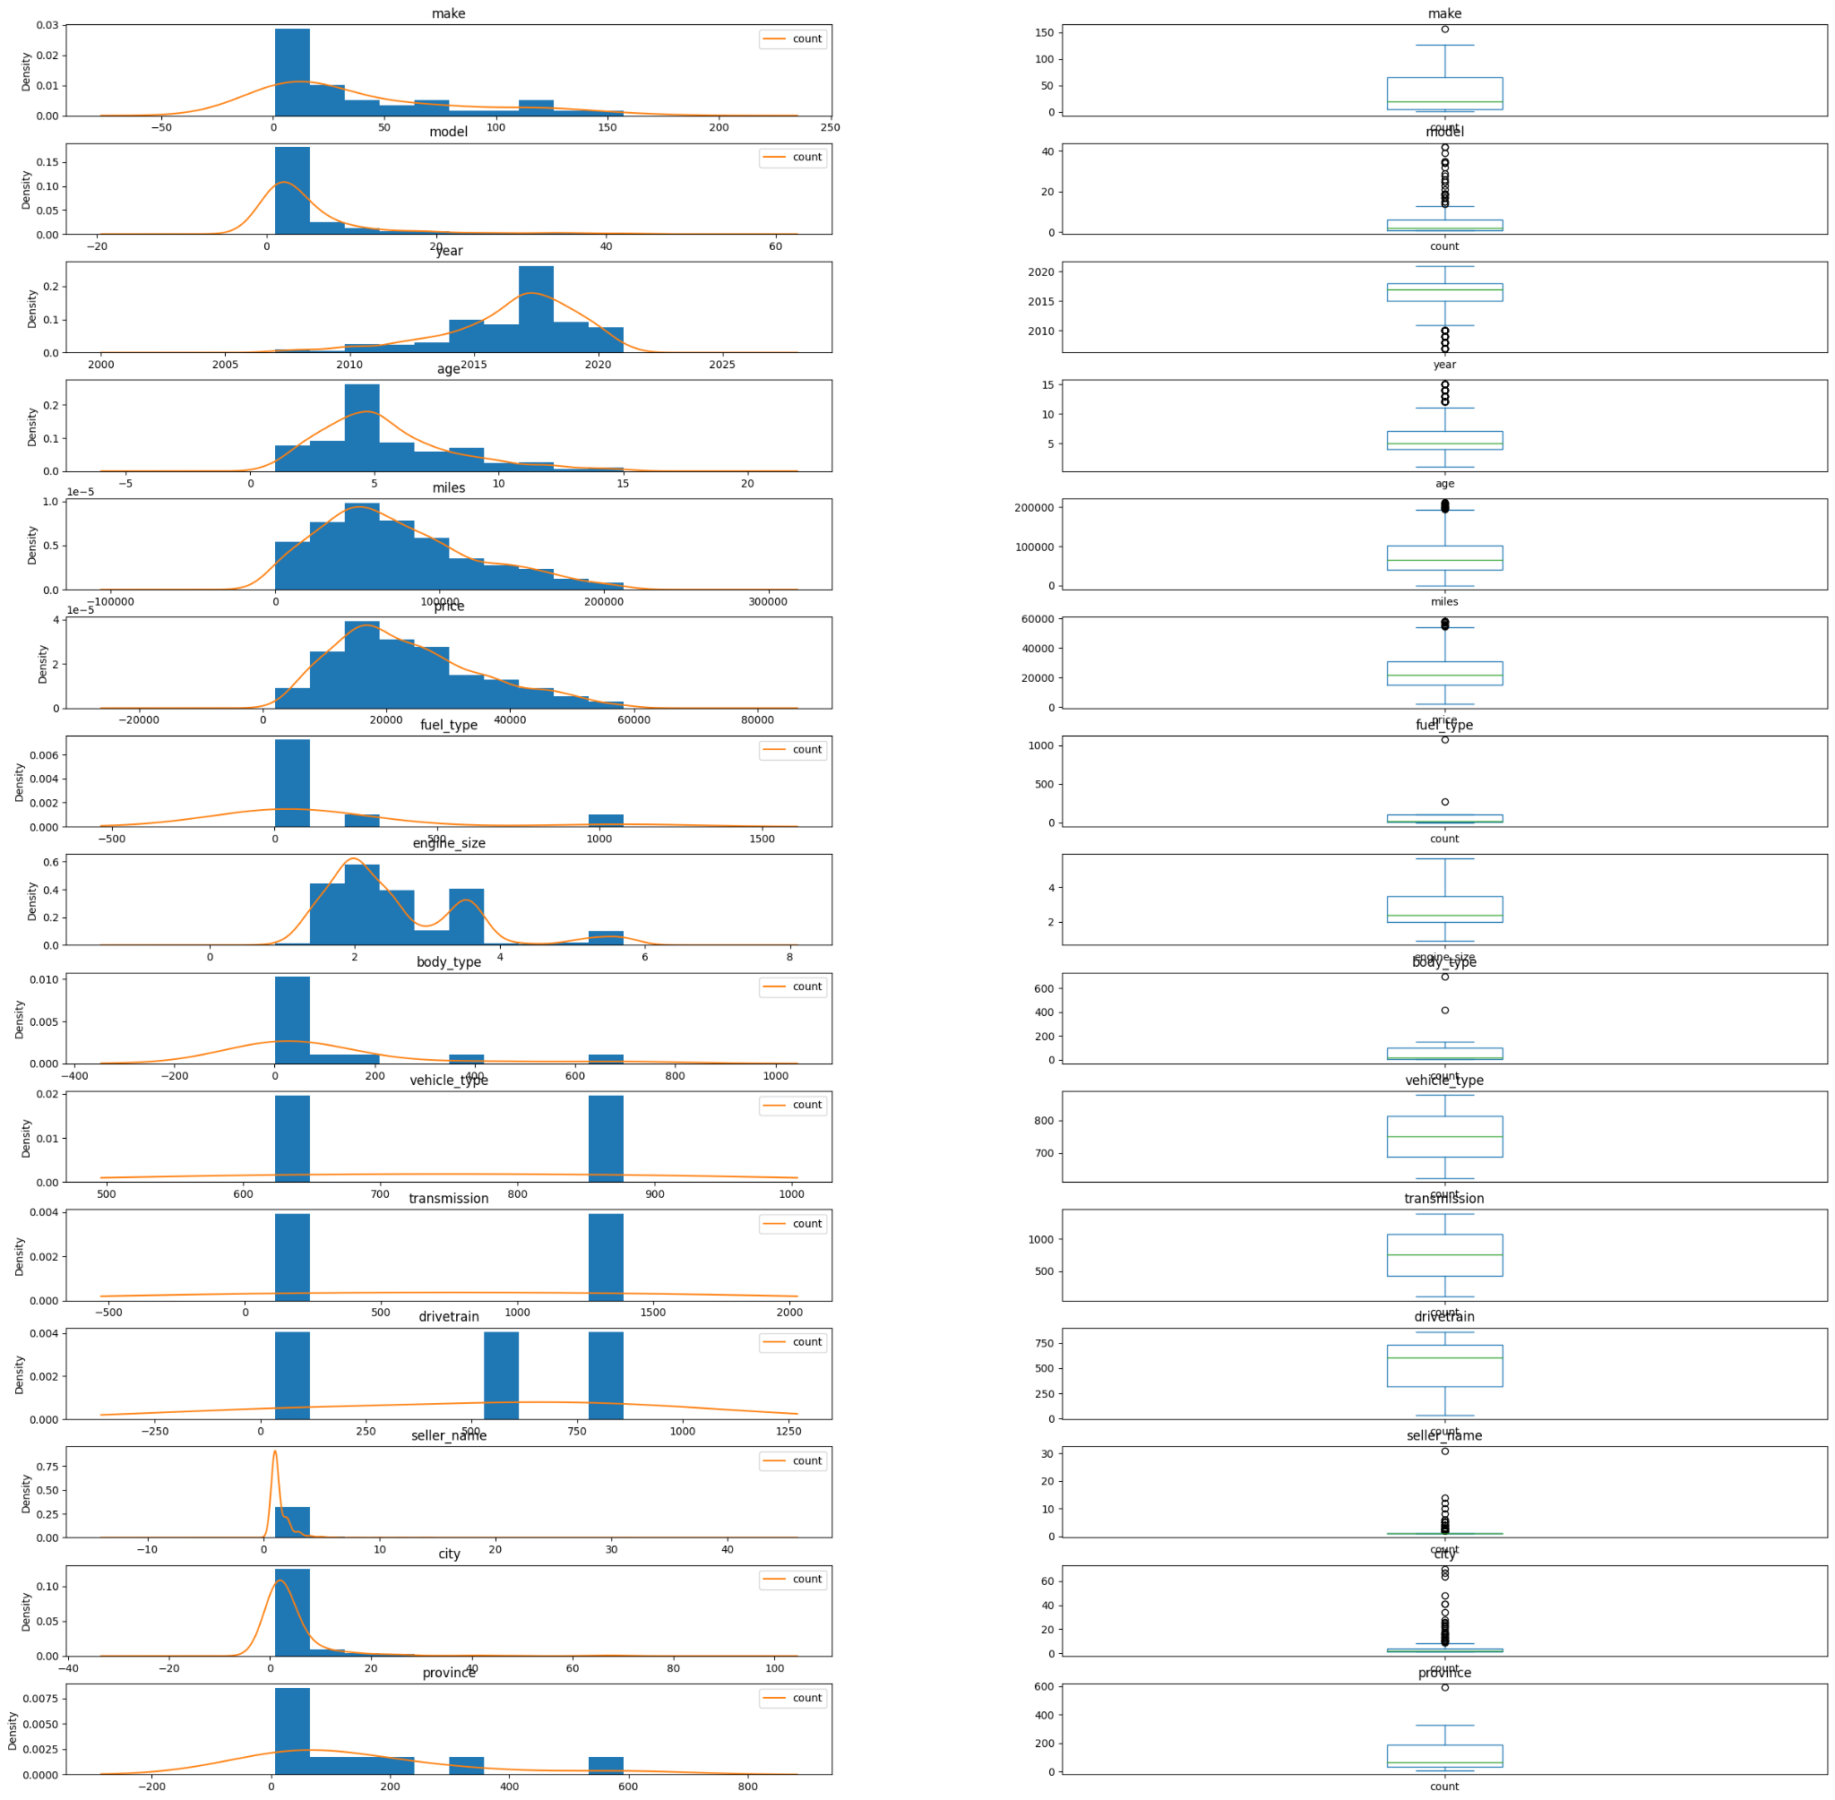

Slide 17
ITERATION TWO

Slide 18
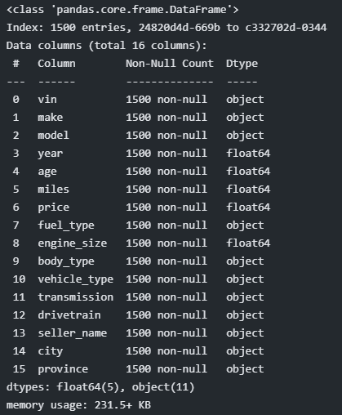
Moving forward, we sub-sample only a fraction of our clean dataset to use for analysis. We settled on 1500 as a reasonably-sized working set.

Slide 19
Feature Engineering(Encoding & Data Scaling)

Slide 20
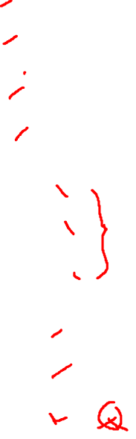
There are 10 categorical attributes in our data that we encoded with the following encoders:
Attribute | Encoder
Make | Label Encoder
Model | Label Encoder
Fuel Type | Label Encoder
Body Type | Label Encoder
Vehicle Type | Frequency Encoder
Transmission | Frequency Encoder
Drivetrain | Frequency Encoder
Seller Name | Label Encoder
City | Label Encoder
Province | Frequency Encoder

Slide 21
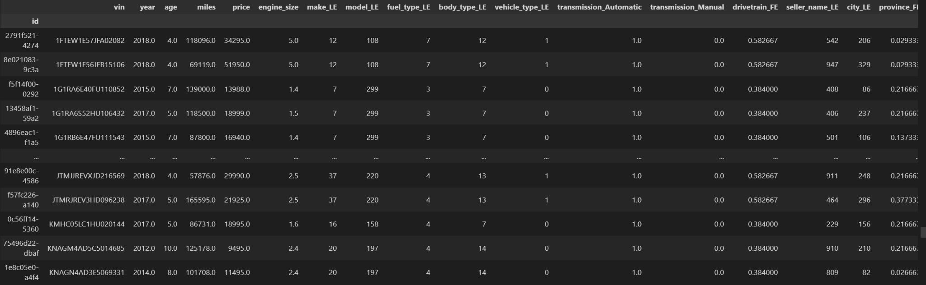
Result of Data Encoding

Slide 22

Data Scaling
We explored all the data scaling methods discussed in class, namely: MinMax, MaxAbs, Robust, Quantile and normalization. We also explored the log transformation.
We then decided to drop the MinMax because it gives the same results as MaxAbs.
We also dropped Z-Score normalizer because it rescales the data to a unit norm, independent of the distribution of the data. We want to preserve the distribution of the data, since a handful of attributes are not normally distributed.
Lastly, we dropped LogFunction transformer because it does not preserve the shape of the original distribution.

Slide 23
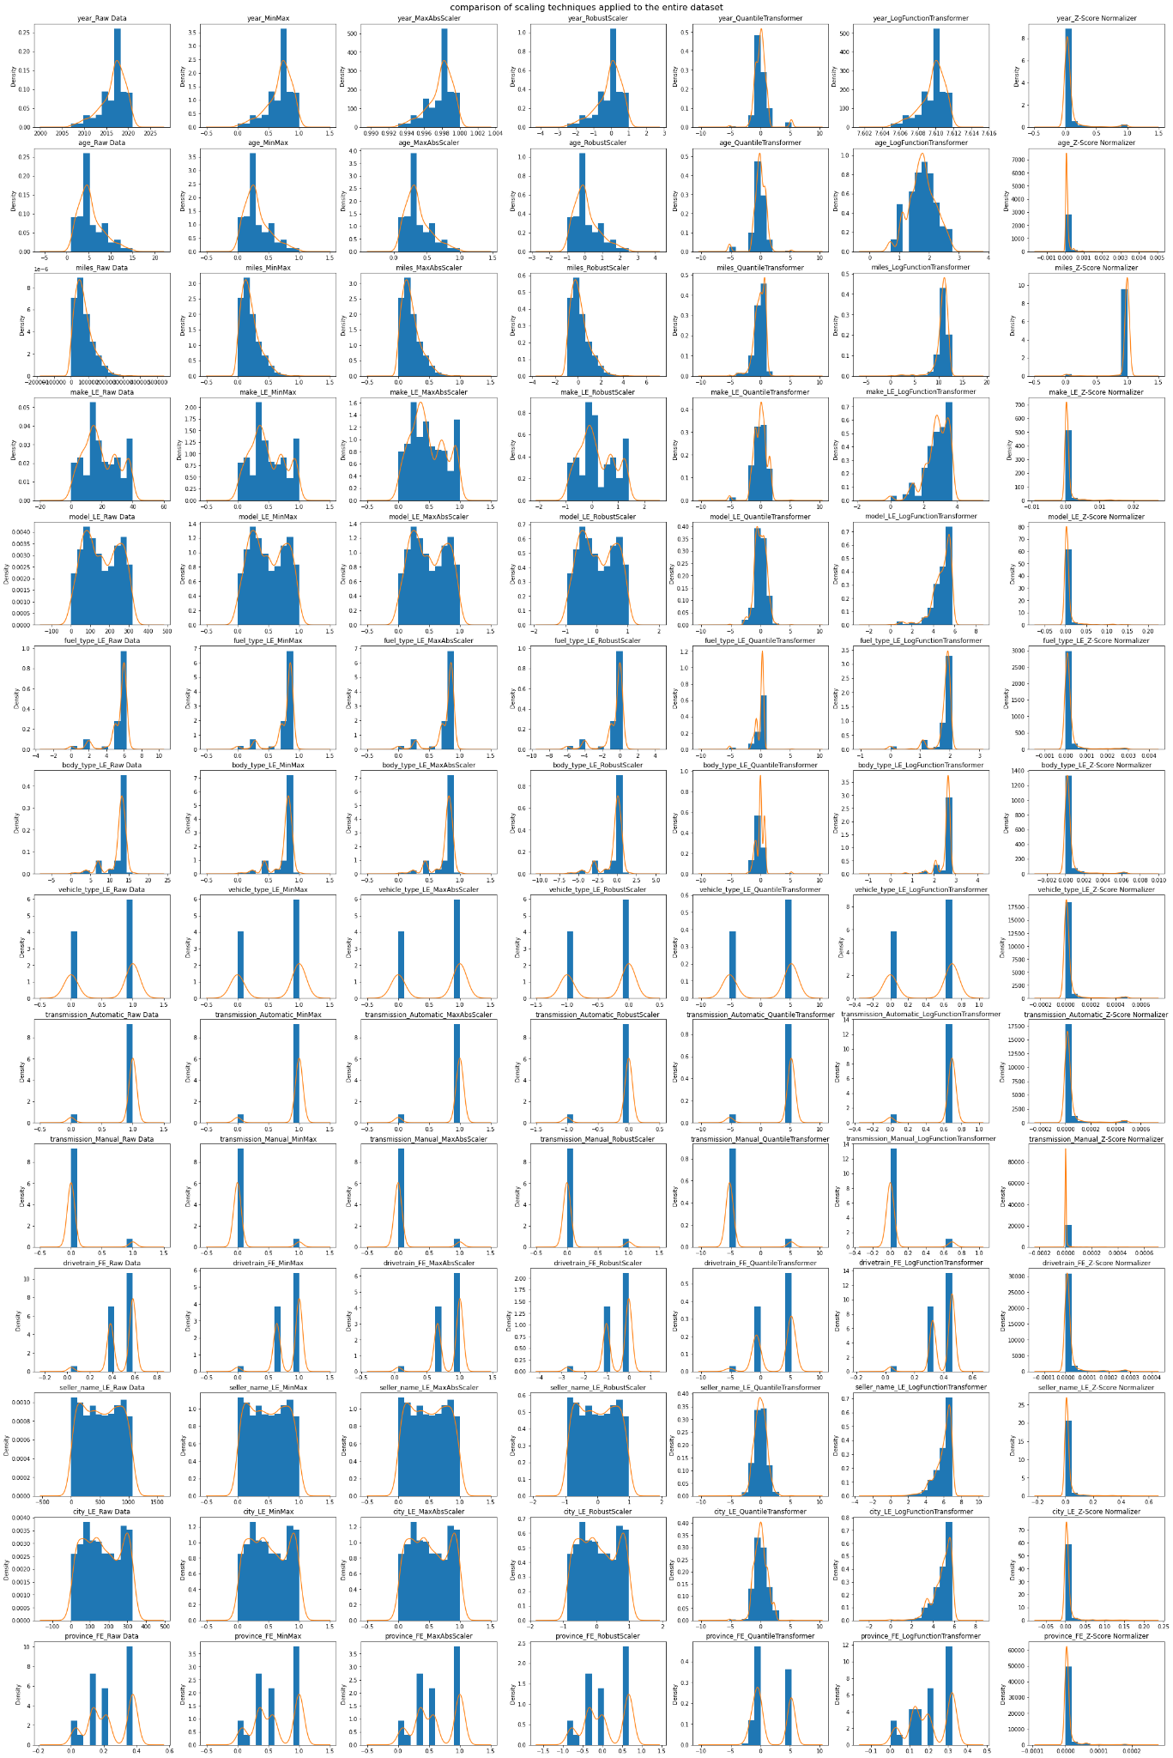

Slide 24
Model Training & Testing

Slide 25
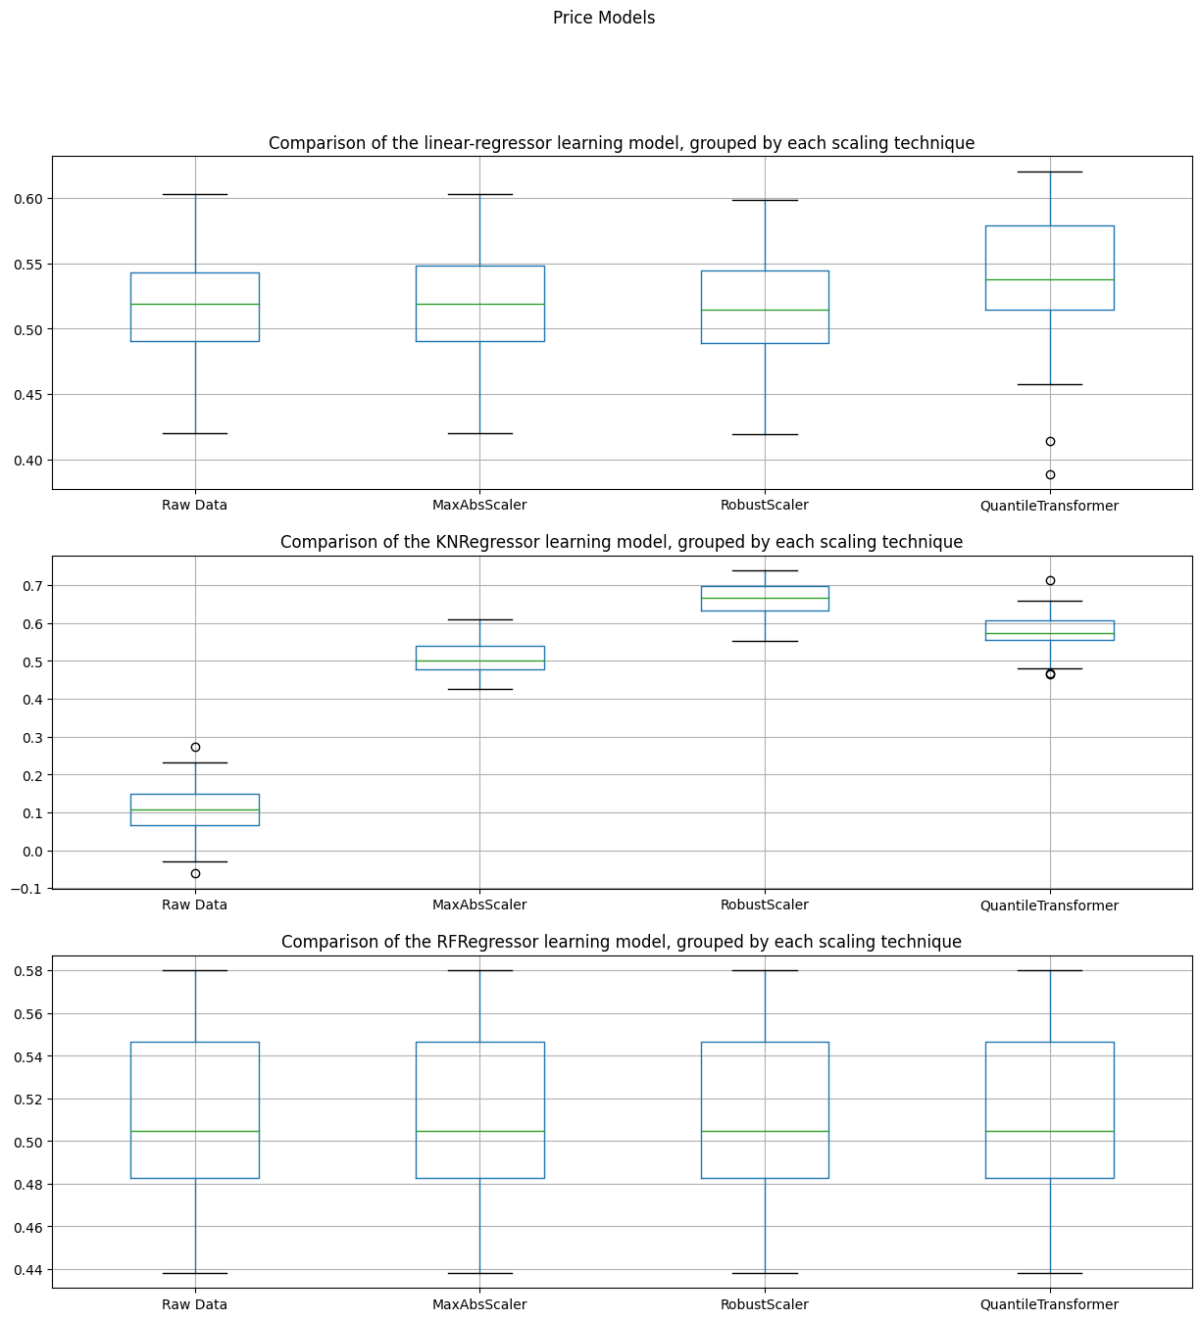

We trained using 3 different Regression Algorithms (LinearRegression, KNRegressor and RandomForest models) on each of our selected scaling techniques.
For the price attribute, the KNRegressor combined with RobustScaler gave the optimal performance

Slide 26
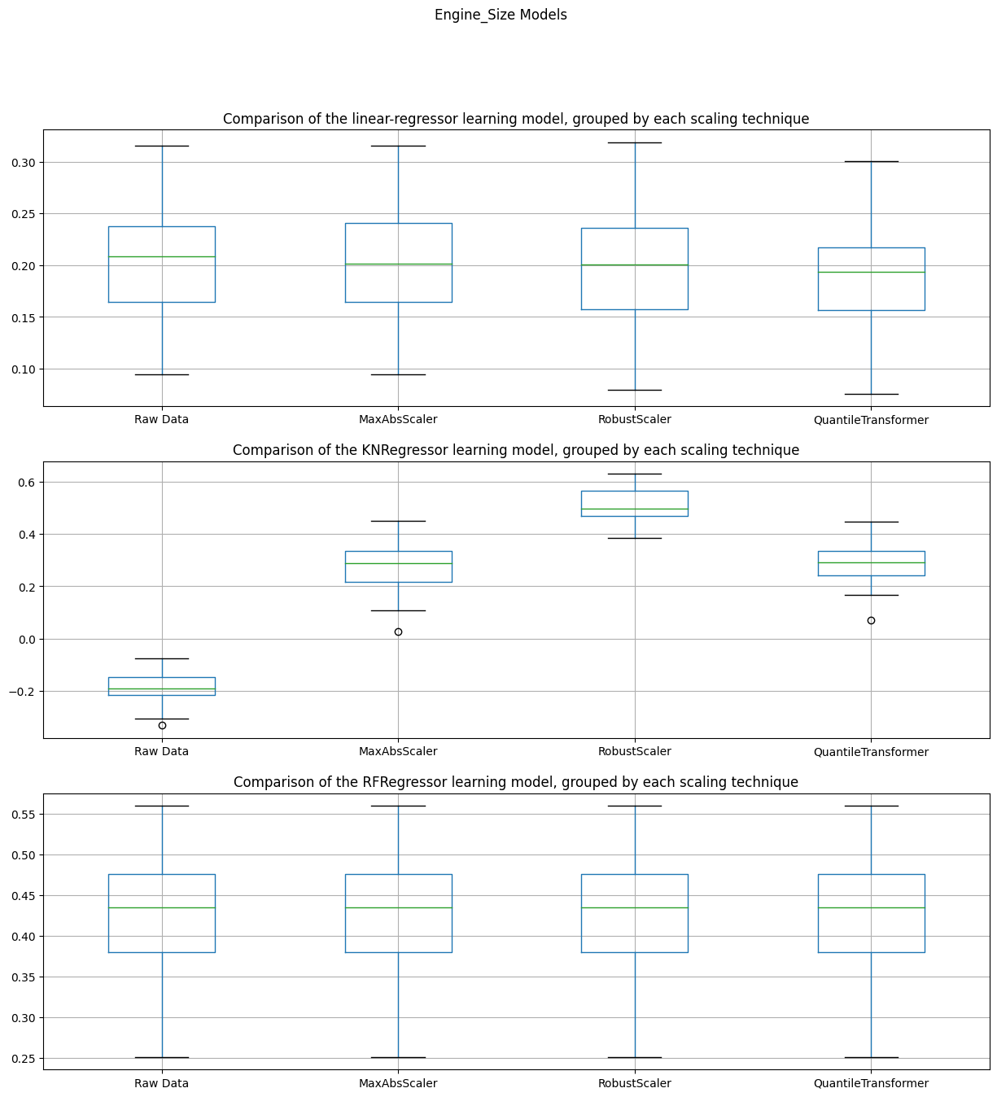

With the engine_size attribute, it’s also clear that KNRegressor combined with Robust Scaler gives us the best performance

Slide 27
Predicting Missing Values and Outliers
Price

Slide 28
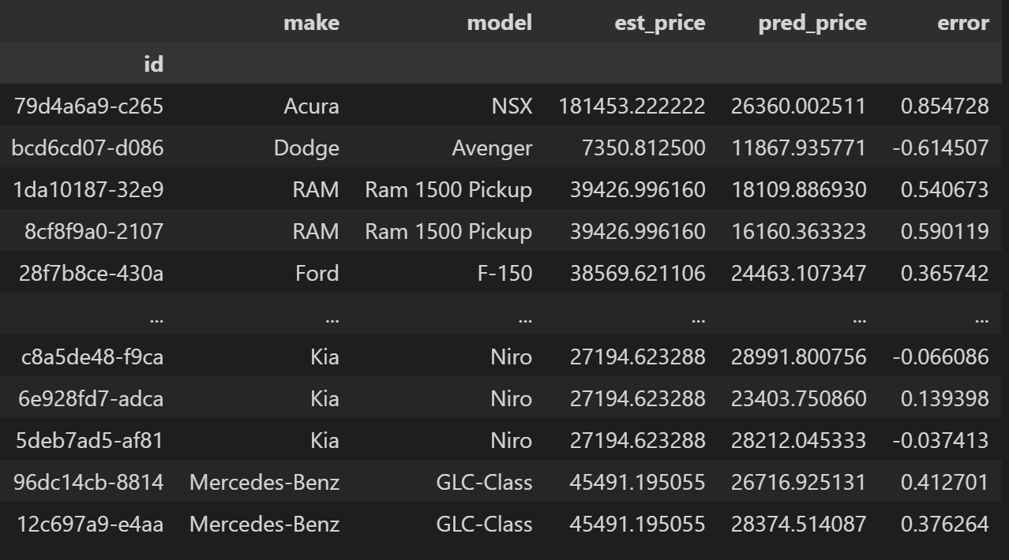
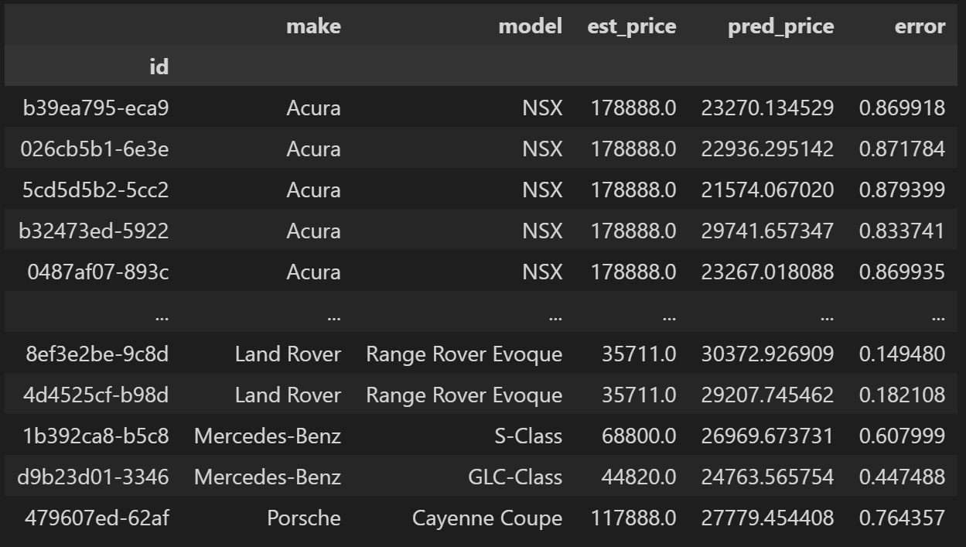
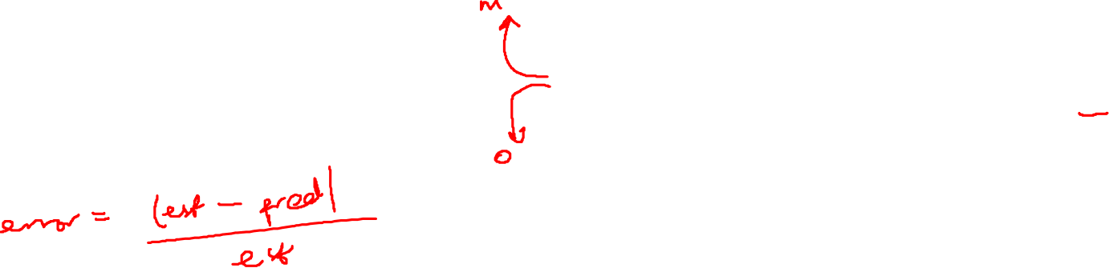
using our best model, KNRegressor, combined with Robust Scaler, we predicted our missing and outlier values for price
we also calculated the relative error between the baseline (estimated missing and outlier values) and the forecasted values

Slide 29
Predicting Missing Values and Outliers
Engine Size

Slide 30
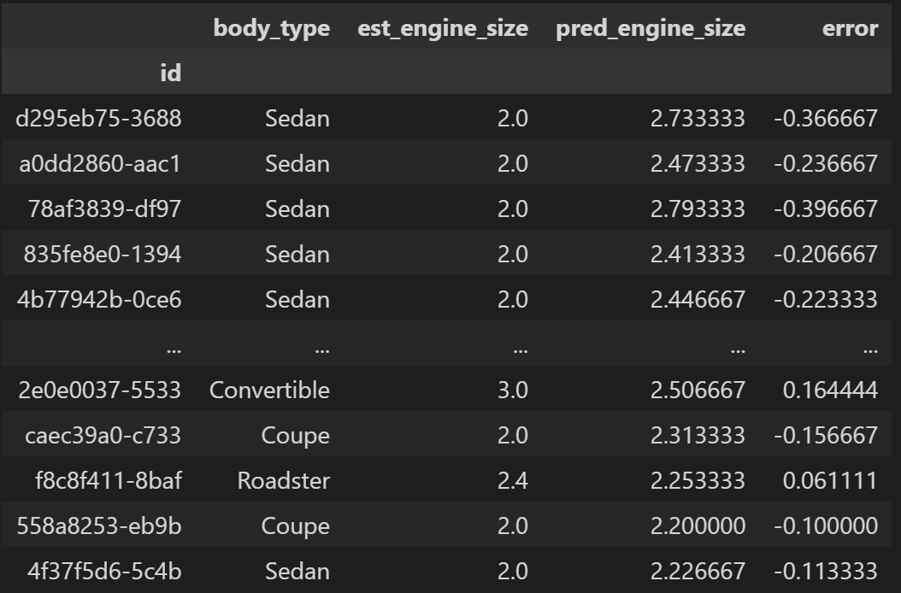
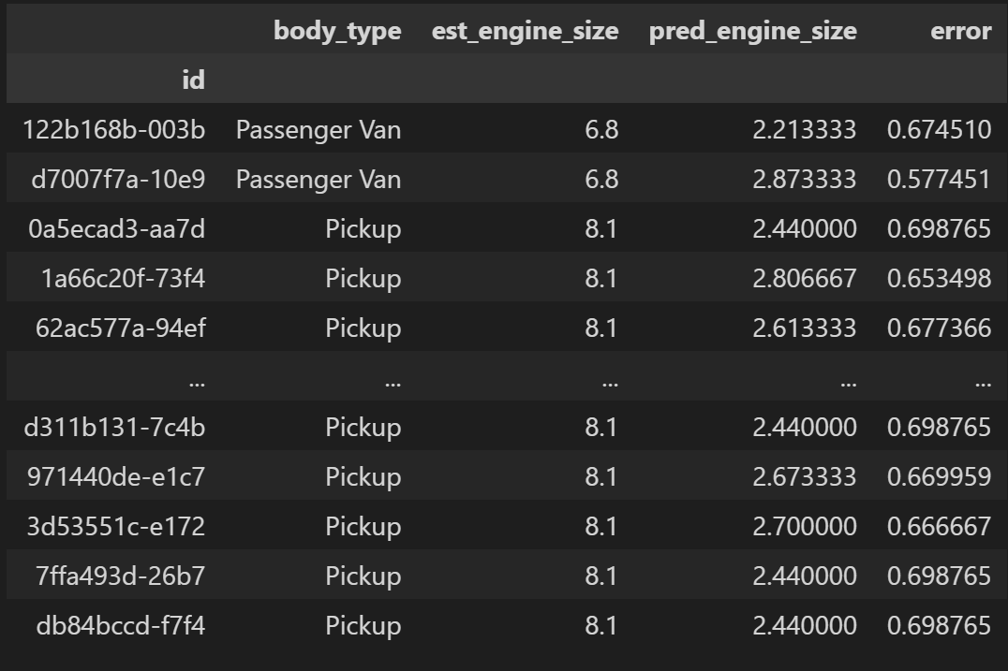
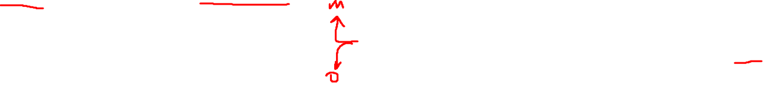
as with price, we used KNRegressor with the RobustScaler to forecast missing and outlier engine_size values
we also calculated the relative error between the baseline and the forecasted values

Slide 31
Supervised Learning Problem Design & Experimentation

Slide 32
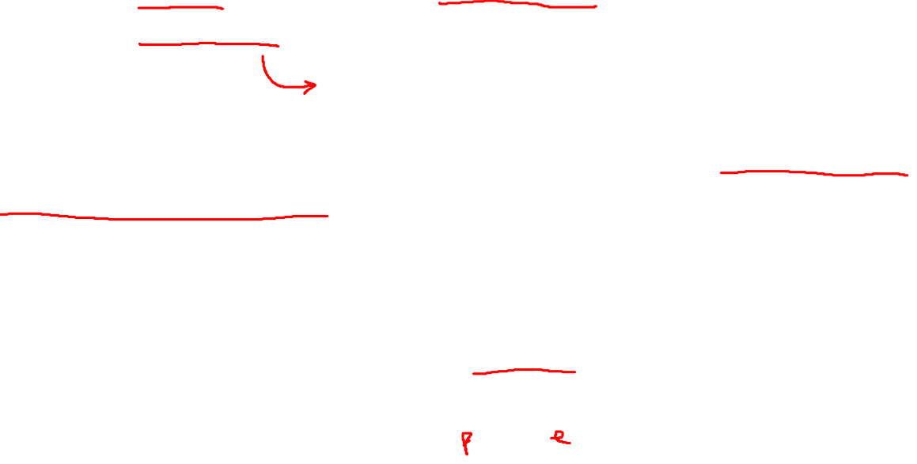
From the get-go, we included attributes that might not be correlated with the attributes we are forecasting
In a bid to improve our model’s performance, we performed some rudimentary feature selection strategies using *f_regression* and *mutual_info_regression* to determine which attributes contribute most to the attributes we are trying to forecast
We also performed hyperparameter-tuning on our best model, KNeighborsRegressor, by running a Grid-Search to determine the best combination of parameters to use

Slide 33
Feature Selection and HyperParameter Tuning
Price

Slide 34
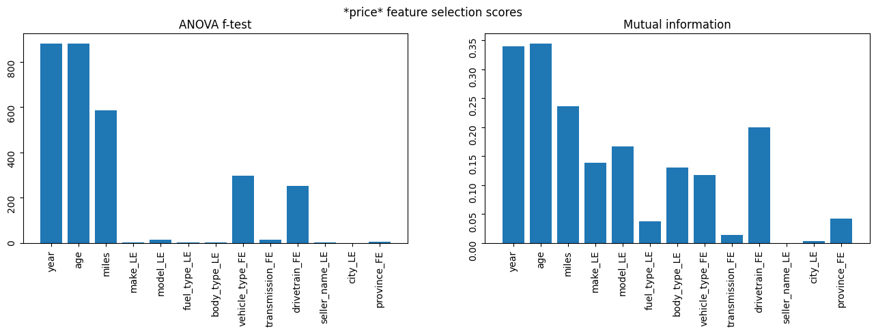

As observed, the following attributes contribute substantially more to the price than all other attributes:
year
miles
make_LE
model_LE
body_type_LE
vehicle_type_FE
drivetrain_FE
As such, we trained our model solely on these attributes and report whether or not there is an improvement in the predictive performance.

Slide 35
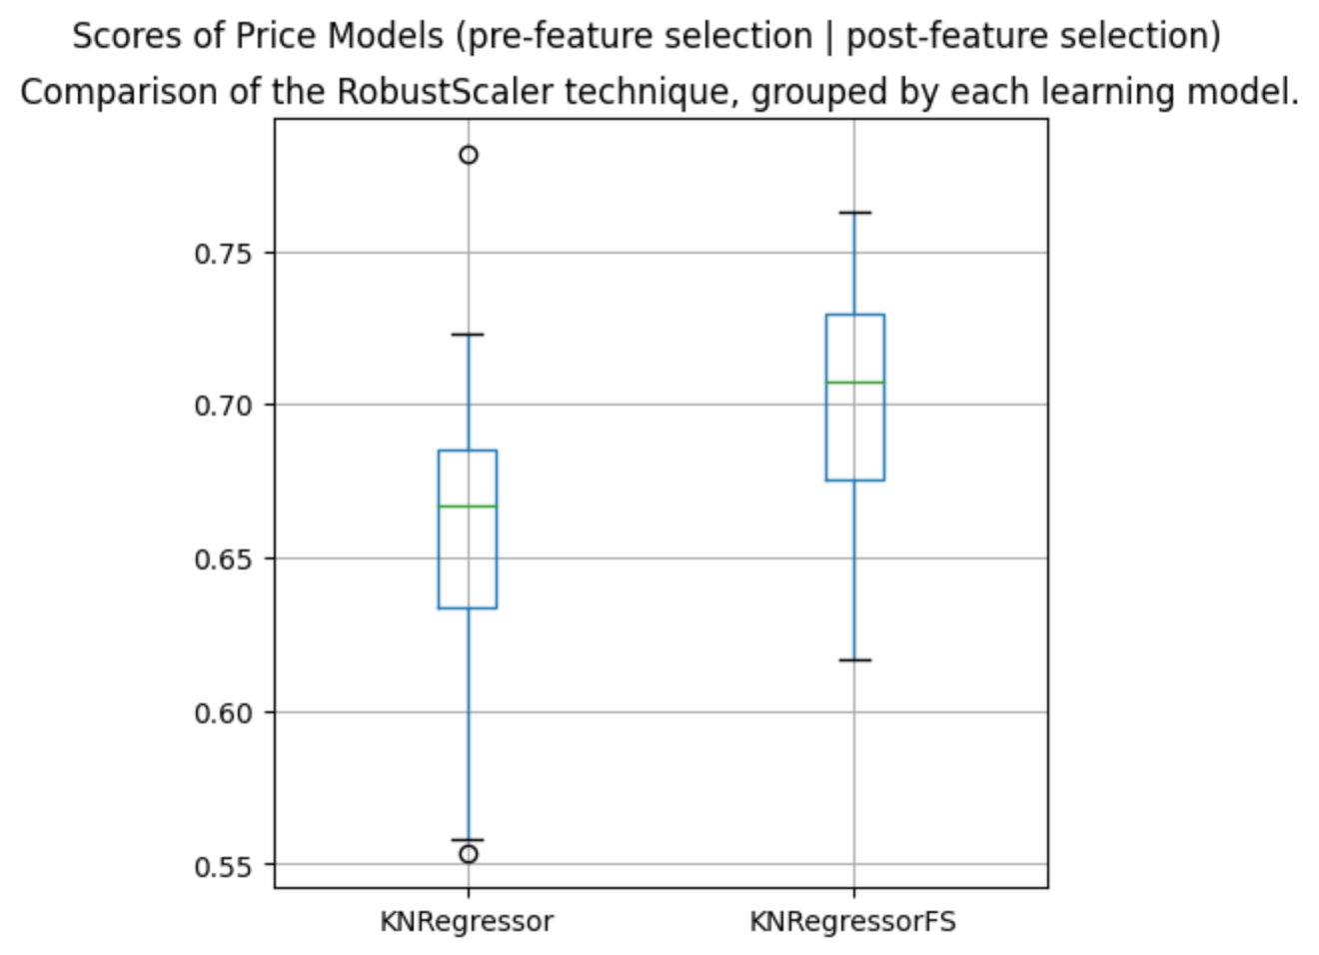
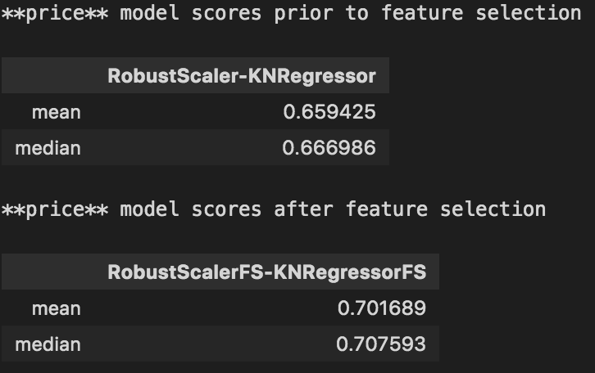

Instance of Grid-Search
Best Params:
{
'metric': 'manhattan', 'n_neighbors': 19, 'weights': 'distance'
}
Using the result of our Grid-Search and selecting the relevant attributes to predict price, we realised that the performance of our model increased from about 66% to about 70% on average*

Slide 36
Re-predicting missing and outlier values
Price

Slide 37
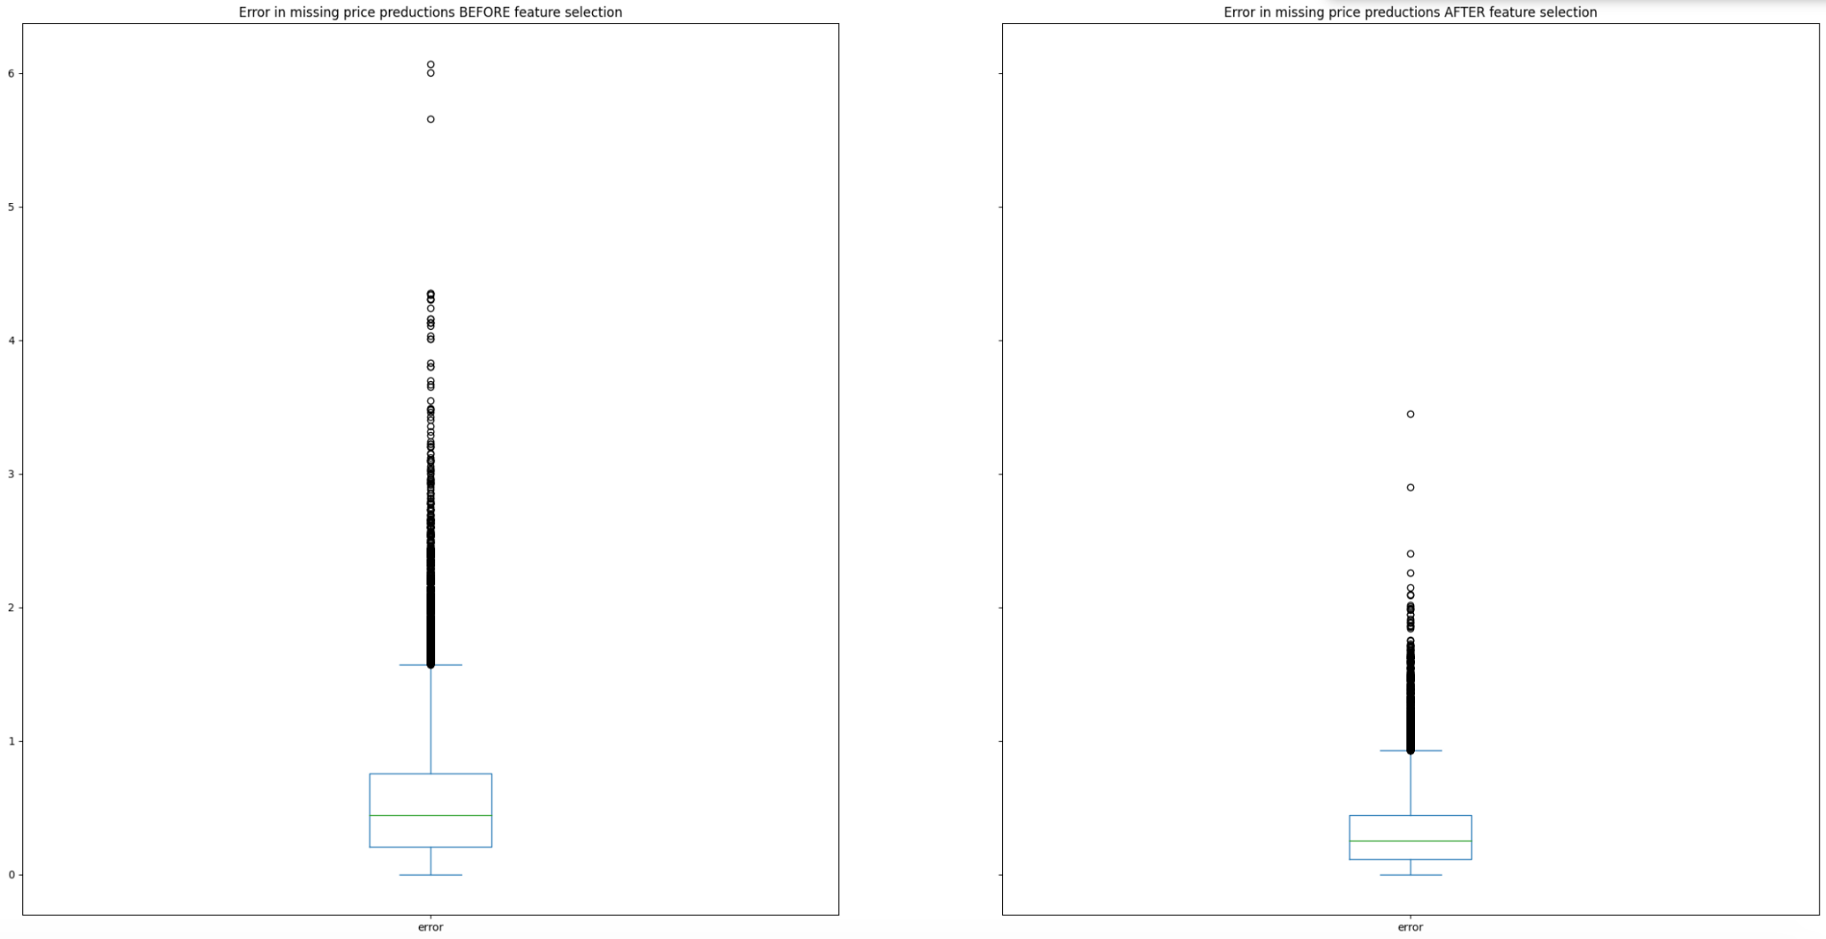


Slide 38
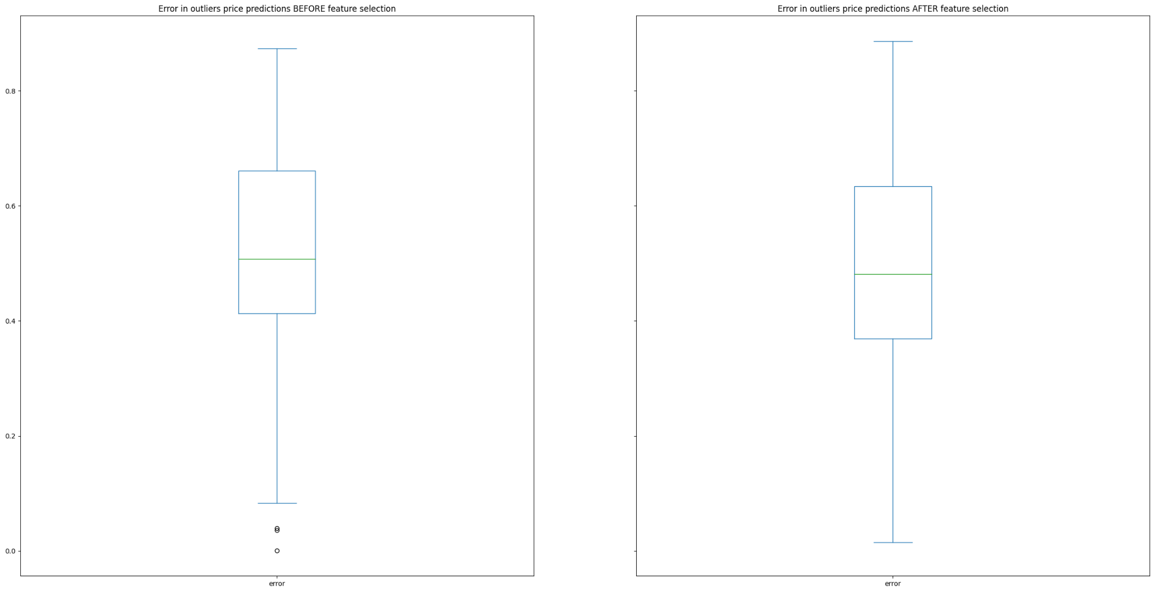

Slide 39
Feature Selection and HyperParameter Tuning
Engine Size

Slide 40
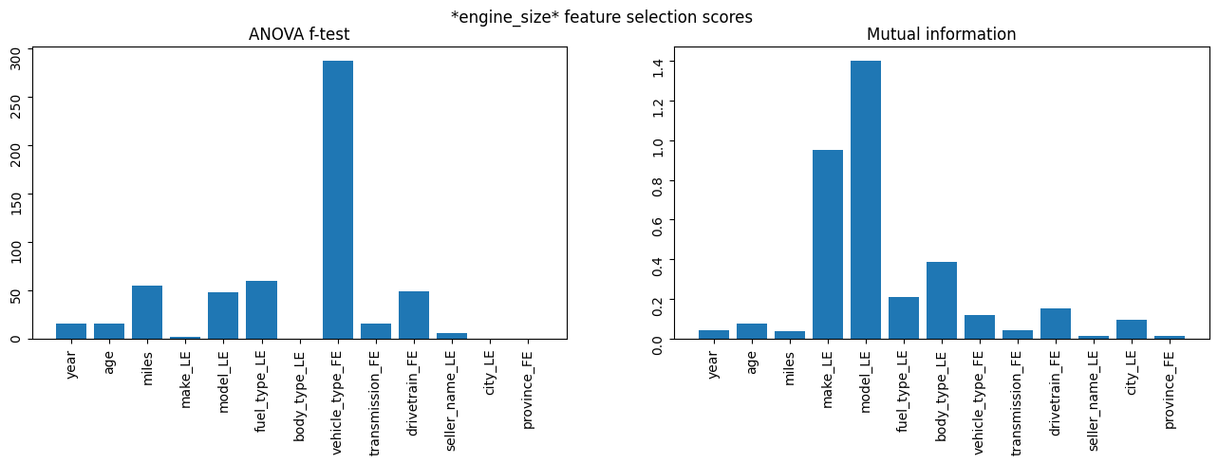
As observed, the following attributes contribute substantially more to the engine_size than all other attributes:
make_LE
model_LE,
fuel_type_LE
body_type_LE
vehicle_type_FE
transmission_FE
drivetrain_FE
As such, we trained our model solely on these attributes and report whether or not there is an improvement in the predictive performance.

Slide 41
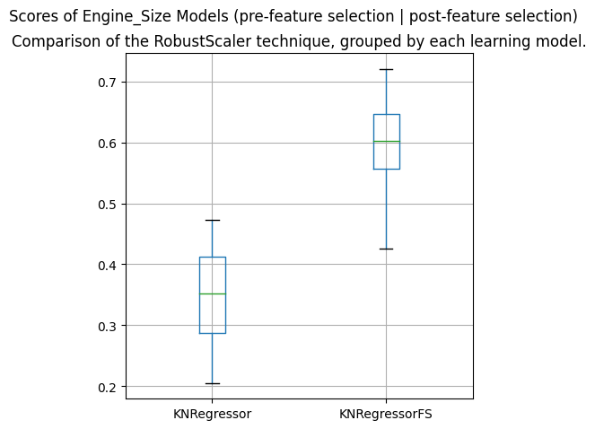
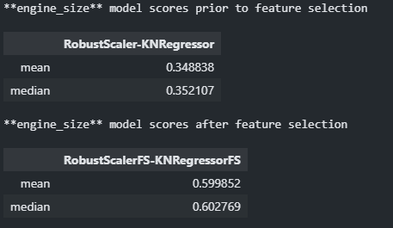
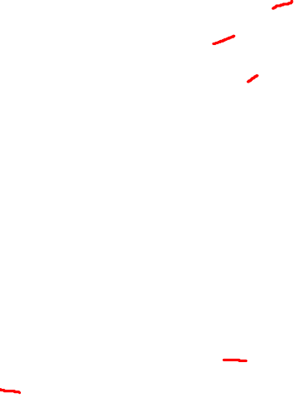
Instance of Grid-Search
Best Params:
{
'metric': 'euclidean', 'n_neighbors’: 19, 'weights': 'uniform'
}
Using the result of our Grid-Search and selecting the relevant attributes to predict engine size, we realised that the performance of our model increased from about 35% to about 60% on average*

Slide 42
Re-predicting missing and outlier values
Engine Size

Slide 43
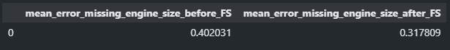
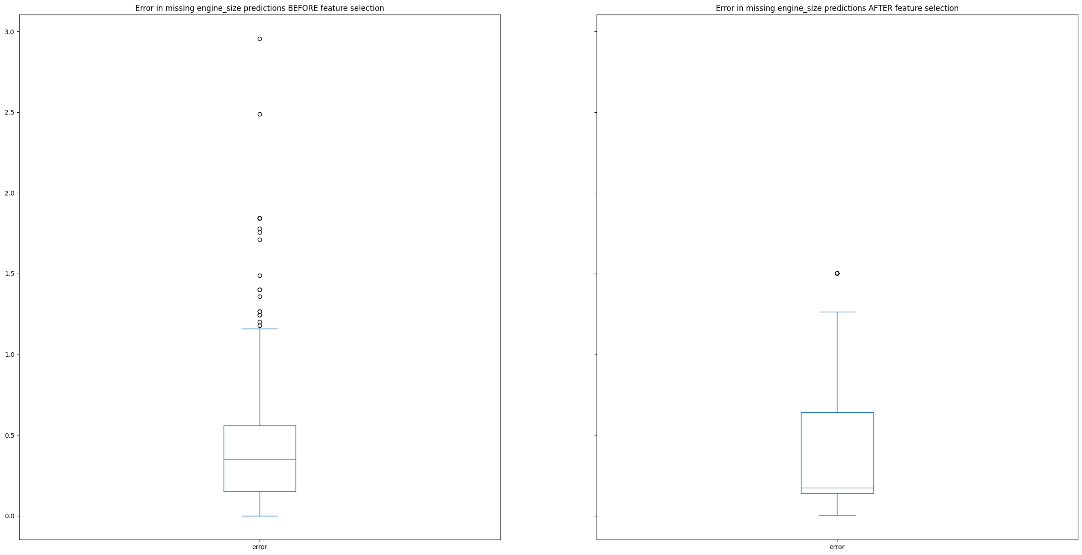
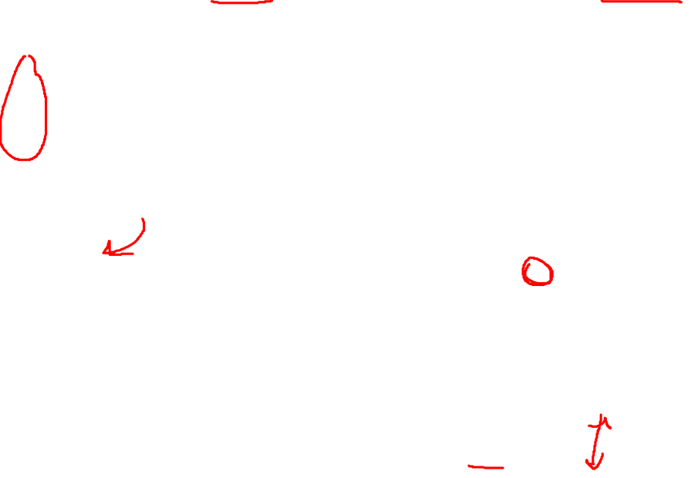

Slide 44
